Slide 1
Defense and tools
Chapter 2

Slide 2
Outline
Securing Modern Web Applications
Secure Application Architecture
Reviewing Code for Security
Vulnerability Discovery,
Defending Against XSS Attacks, Defending Against CSRF Attacks,
Defending Against XXE, Defending Against Injection attacks,
Defending Against DoS, Defending against CORS based attacks
Self-learning Topics: Implement the countermeasures to the attacks using open-source tools

Slide 3
Securing Modern Web Applications

Slide 4
Today’s web applications are much more complex and distributed than their predecessors.
This opens the surface area for attack when compared to older, monolithic web applications, those with server-side rendering and little to no user interaction.
it is important to understand the surface area of a web application, and understand how such a surface area can be mapped and analyzed by a potential hacker.
By understanding the methodology a hacker would use to break into your web application, you should be able to derive the best ways to prioritize your defenses and camouflage your application architecture and logic from malicious eyes

Slide 5
Steps for Securing Modern Web Application
Design Defensive Software Architecture
Comprehensive Code Reviews
Vulnerability Discovery
Vulnerability Analysis
Vulnerability Management
Regression Testing
Mitigation Strategies

Slide 6
Design Defensive Software Architecture
The first step in writing a well-fortified web application starts prior to any software being written.
In the architecture phase of any new product or feature, deep attention to detail should be spent on the data that flows throughout the application.
Defensive software architecture refers to the design and implementation of software systems with a primary focus on security and robustness.
The goal is to build systems that can withstand various types of cyber threats, attacks, and unexpected failures.

Slide 7
Key principles and practices associated with defensive software architecture
Security by Design:
Layered Security:
Least Privilege Principle:
Data Encryption:
Input Validation and Sanitization:
Error Handling and Logging:
Secure Communication Protocols:
Regular Security Audits and Testing:
Dependency Management:
Incident Response Planning:
Notes:
Security by Design:
Integrate security considerations into the software design process from the beginning.
Identify potential security risks and vulnerabilities at the architectural level.
Consider security as a fundamental aspect of the overall system rather than an add-on.
Layered Security:
Implement multiple layers of security controls, such as firewalls, intrusion detection/prevention systems, encryption, and access controls.
Each layer should serve as an additional defense mechanism, providing redundancy in case one layer is compromised.
Least Privilege Principle:
Limit the access and permissions of users, processes, and components to the minimum necessary for their tasks.
Reduce the potential impact of security breaches by minimizing the privileges granted to entities within the system.
Data Encryption:
Use encryption algorithms to protect sensitive data at rest, in transit, and during processing.
Implement secure key management practices to safeguard encryption keys.
Input Validation and Sanitization:
Thoroughly validate and sanitize all user inputs to prevent common vulnerabilities such as SQL injection, cross-site scripting (XSS), and other injection attacks.
Apply input validation at multiple layers of the software stack.
Error Handling and Logging:
Implement robust error handling mechanisms to gracefully handle unexpected situations without disclosing sensitive information.
Maintain detailed logs for auditing and monitoring purposes to detect and respond to security incidents.
Secure Communication Protocols:
Use secure communication protocols (e.g., HTTPS/TLS) to encrypt data exchanged between different components of the system.
Disable deprecated and insecure protocols to minimize attack vectors.
Regular Security Audits and Testing:
Conduct regular security audits and penetration testing to identify and address vulnerabilities.
Implement automated security testing as part of the continuous integration and deployment (CI/CD) pipeline.
Dependency Management:
Regularly update and patch third-party libraries and components to address known vulnerabilities.
Monitor for security advisories related to dependencies and act promptly to mitigate risks.
Incident Response Planning:
Develop and regularly update an incident response plan to guide the organization's response in case of a security incident.
Conduct drills and simulations to ensure that the team is prepared to handle security breaches effectively.

Slide 8
Comprehensive Code Reviews
Comprehensive code reviews are a crucial aspect of the software development process, aiming to improve code quality, identify bugs, and ensure adherence to coding standards.
Code review processes improve quality assurance, reduce technical debt, and eliminate easy-to-find programming mistakes.
Code reviews are also a crucial step in ensuring that released code meets security standards.
In order to reduce conflict of interest, commits to source code version control should not only be reviewed by members of the committer’s team, but also by an unrelated team

Slide 9
The major points to look out for are:
How is data being transmitted from point A to point B (typically over a network, and in a specific format)?
How is data being stored?
When data gets to the client, how is it presented to the user?
When data gets to the server, what operations occur on it and how is it persisted?

Slide 10
Vulnerability Discovery
The old-fashioned way of finding vulnerabilities is either by customer notification or (worst case) widespread public disclosure.
More modern methods for finding vulnerabilities exist, and can save your product from a wave of bad PR, lawsuits, and loss of customers.
Today’s most security conscious companies use a combination of the following:
Bug bounty programs
Internal red/blue teams
Third-party penetration testers
Corporate incentives for engineers to log known vulnerabilities
By making use of one or more of these techniques to find vulnerabilities before your customers or the public do

Slide 11
Vulnerability Analysis
A vulnerability assessment is the process of defining, identifying, classifying and prioritizing vulnerabilities in computer systems, applications and network infrastructures.
After finding a vulnerability in your web application, there are several steps that should be taken to properly triage, prioritize, and manage that vulnerability.
Risk and priority can be derived from: •
Financial risk to the company
Difficulty of exploitation
Type of data compromised
Existing contractual agreements
Mitigation measures already in place

Slide 12
Vulnerability Management
After determining the risk and prioritization of a vulnerability, the next step involves developing tracking methods to ensure the solution is progressing in a timely manner and alongside your contractual obligations.
During this time frame if the vulnerability can be recorded, additional logging should be put in place to ensure that no hacker attempts to take advantage of the vulnerability while the fix is being developed.
Managing vulnerabilities is an ongoing process.
Your vulnerability management process should be carefully planned out and written down so that your progress can be recorded.

Slide 13
Regression Testing
Regression testing is performed to find out whether the updates or changes had caused new defects in the existing functions.
Regression testing is re-running functional and non-functional tests to ensure that previously developed and tested software still performs as expected after a change.
After deploying a fix that resolves a vulnerability, the next step is to write a regression test that will assert that the fix is valid and the vulnerability no longer exists.
Notes:
Steps for Security Regression Testing:
1. Test Existing Security Features
Test Case 1: Verify that password strength enforcement still works (e.g., requires at least 8 characters, a mix of uppercase, lowercase, numbers, and symbols).
Test Case 2: Ensure account lockout policies remain functional after several failed login attempts.
Test Case 3: Confirm that user session tokens are invalidated upon logout.
2. Validate New Changes
Test Case 4: Ensure that the MFA system properly triggers for accounts enabled with this feature.
Test Case 5: Verify that MFA tokens expire after a specific time, and reused tokens are rejected.
Test Case 6: Test the fallback mechanism for users without MFA enabled, ensuring it doesn’t bypass authentication checks.
3. Check for Common Security Vulnerabilities
Test Case 7: Conduct SQL injection tests on the login endpoint to verify proper input sanitization.
Test Case 8: Validate that the system is protected against Cross-Site Scripting (XSS) in error messages displayed during login.
Test Case 9: Test for Cross-Site Request Forgery (CSRF) by ensuring that the login form includes proper CSRF tokens.
4. Test Integration with Other Components
Test Case 10: Verify the integration of the MFA system with third-party authentication services (e.g., SMS or email providers).
Test Case 11: Ensure proper logging of security-relevant events (e.g., login attempts, failed MFA attempts) without exposing sensitive data in logs.
5. Automate and Retest Known Security Issues
If previous vulnerabilities were identified, rerun automated security tests (e.g., using tools like OWASP ZAP or Burp Suite) to confirm they are still resolved.

Slide 14
Mitigation Strategies
The practice of reducing the impact of potential risks by developing a plan to manage, eliminate, or limit setbacks as much as possible.
This is a practice that happens all the way from the architecture phase to the regression testing phase.
Mitigation comes in the form of secure coding best practices, secure application architecture, regression testing frameworks, secure software development life cycle (SSDL), and secure-by-default developer mindset and development frameworks.

Slide 15
Secure Application Architecture

Slide 16
In software engineering, the role of an architect is to design modules at a high level and evaluate the best ways for modules to communicate with each other.
building software architecture is a delicate process that carries a large amount of risk because re-architecture and refactor are expensive processes once an application has already been built.
Security architecture includes a similar risk profile to software or building architecture.
Often, vulnerabilities can be prevented easily in the architecture phase with careful planning and evaluation.

Slide 17
Analyzing Feature Requirements
collect all the business requirements that the product or feature is expected to implement.
Case Study:
MegaBank has decided to capitalize on its newly found popularity by beginning its own merchandising brand. MegaBank’s new merchandising brand, MegaMerch, will offer a collection of high-quality cotton T-shirts, comfortable cotton/elastic sweatpants, and men’s and women’s swimwear with the MegaMerch (MM) logo.

Slide 18
In order to distribute merchandise under the new MegaMerch brand, MegaBank would like to set up an ecommerce application that meets the following requirements:
Users can create accounts and sign in.
User accounts contain the user’s full name, address, and date of birth.
Users can access the front page of the store that shows items.
Users can search for specific items.
Users can save credit cards and bank accounts for later use.
A high-level analysis of these requirements tells us a few important tidbits of information:
We are storing credentials.
We are storing personal identifier information.
Users have elevated privileges compared to guests.
Users can search through existing items.
We are storing financial data.

Slide 19
A few of the risk areas derived from this analysis are as follows:
Authentication and authorization: How do we handle sessions, logins, and cookies?
Personal data: Is it handled differently than other data? Do laws affect how we should handle this data?
Search engine: How is the search engine implemented? Does it draw from the primary database as its single source of truth or use a separate cached database?

Slide 20
Authentication and Authorization
Authentication and Authorization System is important as application is going to store credentials and offer a different user experience to guests and registered users.
This means application must allow users to log in, as well as be able to differentiate among different tiers of users when determining what actions these users are allowed.
we must consider the following risks: •
How do we handle data in transit?
How do we handle the storage of credentials?
How do we handle various authorization levels of users?

Slide 21
How do we handle data in transit?
Secure Sockets Layer and Transport Layer Security
Secure Sockets Layer (SSL) and Transport Layer Security (TLS) are the two major cryptographic protocols in use today for securing in-transit data from malicious eyes in the middle of any network.
TSL cannot interpolate with older versions of SSL due to the amount of architectural differences between the two.
TLS offers the most rigid security, while SSL has higher adoption but multiple vulnerabilities that reduce its integrity as a cryptographic protocol.

Slide 22
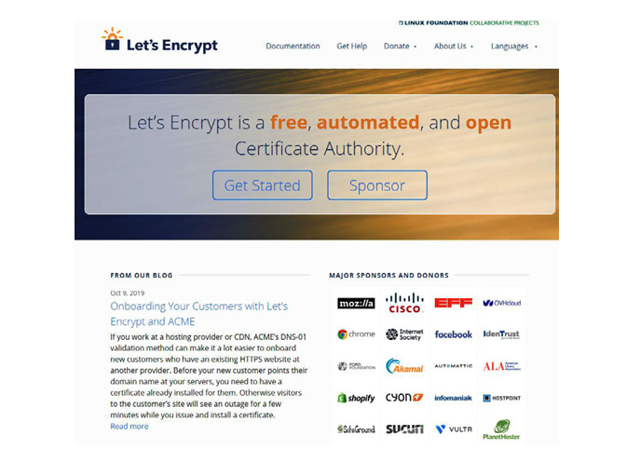
Notes:
Let's Encrypt is a new Certificate Authority (CA) that offers FREE SSL certificates that are just as secure as paid certificates. This project was pioneered to make encrypted connections the default standard throughout the Internet.

Slide 23
Secure Credentials
Creating a secure password has less to do with the length and number of special characters, but instead has everything to do with the patterns that can be found in the password.
In cryptography, this is known as entropy—the amount of randomness and uncertainty. You want passwords with a lot of entropy.
it is not so much the length of the password that will protect you, but instead the lack of observable patterns and avoidance of common words and phrases.
Instead, we should make it difficult for a user to develop a password that contains a number of well-known patterns by having certain requirements.
For example, we can reject any password in a top one thousand password list and tell the user it is too common.
We should also prevent our users from using birthdates, first name, last name, or any part of their address.

Slide 24
How do we handle the storage of credentials?
Hashing Credentials
When storing sensitive credentials, we should never store in plain text.
Instead, we should hash the password the first time we see it prior to storing it.
hashing algorithms are not reversible.
Today’s hashing algorithms can represent multiple-megabyte strings of characters in just 128 to 264 bits of data.
hash is that modern hashing algorithms have almost no collision in practical application
When cracking passwords, slow hashing algorithms are essential because the hacker will be automating the password to hash process.

Slide 25
Let’s consider three cases where a hacker gets access to MegaMerch’s databases:
Case #1
Passwords stored in plain text
Result : All passwords compromised
Case #2
Passwords hashed with MD5 algorithm
Result : Hacker can crack some of the passwords using rainbow tables (a precomputed table of hash→password; weaker hashing algorithms are susceptible to these)
Case #3 Passwords hashed with BCrypt
Result : It is unlikely any passwords will be cracked

Slide 26
Bcrypt
the “B” comes from Blowfish Cipher, a symmetric-key block cipher
“Crypt” is the name of the default hashing function that shipped with Unix OSs.
Bcrypt is a valuable tool to use to hash and store passwords. Its major benefits include:
Bcrypt is a slow-functioning algorithm that takes time to create password hashes and requires time to decrypt them, significantly slowing hacker attempts to break the bcrypt hash.
Adding a random piece of data and hashing it with the password helps generate unique password hashes resistant to rainbow table attacks.
Bcrypt is an adaptive tool that can evolve with hardware and software optimization.

Slide 27
PBKDF2
PBKDF2 (Password-Based Key Derivation Function 2) is a widely used method of protecting passwords.
A key derivation function such as PBKDF2 is designed to make it more difficult for an attacker to crack a password, even if they possess the hashed password value.
PBKDF2 is based on a concept known as key stretching.
Key stretching algorithms will rapidly generate a hash on the first attempt, but each additional attempt will become slower and slower.
As a result, PBKDF2 makes brute forcing a computationally expensive process.

Slide 28
2FA
Two Factor Authentication (2FA or TFA) is the technical term for the process of requiring a user to verify their identity in two unique ways before they are granted access to the system.
Traditionally, users have relied on and are accustomed to authentication systems that require them to provide a unique identifier such as an email address, username or phone number and a correct password or pin to gain access to the system.

Slide 29
PII and Financial Data
Personally identifiable information (PII) uses data to confirm an individual's identity.
Sensitive personally identifiable information can include your full name, Social Security Number, driver's license, financial information, and medical records.
Non-sensitive personally identifiable information is easily accessible from public sources and can include your zip code, race, gender, and date of birth.
Passports contain personally identifiable information.
Social media sites may be considered non-sensitive personally identifiable information.
Similar rules to PII apply to financial data, such as credit card numbers (also included under PII laws in some countries).
A smaller company might find that rather than storing PII and financial details on its own, a more effective strategy could be to outsource the storage of such data to a compliant business that specializes in data storage of that type.

Slide 30
Searching
Any web application implementing its own custom search engine should consider the implications of such a task.
Search engines typically require data to be stored in a way that makes particular queries very efficient.
How data is ideally stored in a search engine is much different than how data is ideally stored in a general purpose database.
most web applications implementing a search engine will need a separate database from which the search engine draws its data.

Slide 31
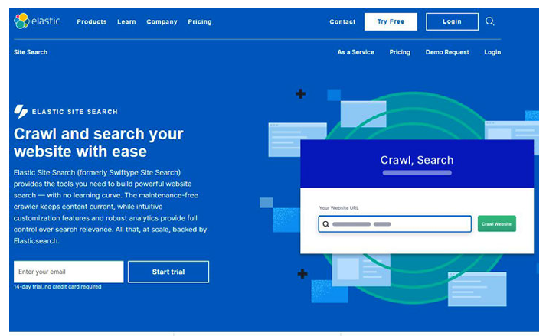
Elasticsearch is a search engine based on the Lucene library. It provides a distributed, multitenant-capable full-text search engine with an HTTP web interface and schema-free JSON documents

Slide 32
Outline
Securing Modern Web Applications
Secure Application Architecture
Reviewing Code for Security
Vulnerability Discovery,
Defending Against XSS Attacks, Defending Against CSRF Attacks,
Defending Against XXE, Defending Against Injection attacks,
Defending Against DoS, Defending against CORS based attacks
Self-learning Topics: Implement the countermeasures to the attacks using open-source tools

Slide 33
Reviewing Code for Security

Slide 34
Code review is a critical component of the software development lifecycle.
It serves as a crucial checkpoint to identify and rectify security vulnerabilities, ensuring that software remains resilient to potential threats throughout its lifespan
Purpose: The primary goal of a secure code review is to identify and mitigate security vulnerabilities in the codebase, reducing the risk of potential security breaches and vulnerabilities being exploited.
Focus: A secure code review specifically looks for security-related issues, such as input validation problems, authentication and authorization flaws, data leakage, hardcoded data, SQL injection, Cross-Site Scripting (XSS), and other vulnerabilities that could be exploited by attackers.
Participants: Secure code reviews often involve security experts or specialized security teams in addition to developers. These experts have a deep understanding of security principles and threats and can identify potential security issues that might be missed in a standard code review.

Slide 35
How to Start a Code Review
A first step in reviewing code for security is to pull the branch in question down to a local development machine.
Here is a common local review flow that can be done from the terminal:
Check out master with git checkout master.
Fetch and merge the latest master with git pull origin master.
Check out the feature branch with git checkout <username>/feature.
Run a diff against the master with git diff origin/master...
The git diff command should return two things:
A list of files that differ on master and the current branch
A list of changes in those files between master and the current branch

Slide 36
Archetypical Vulnerabilities Versus Custom Logic Bugs
Archetypical Vulnerabilities:
Definition: Archetypical vulnerabilities refer to common and well-known security issues that have been identified and categorized over time.
Examples:
Buffer overflows
SQL injection
Cross-Site Scripting (XSS)
Cross-Site Request Forgery (CSRF)
Insecure Direct Object References (IDOR)
Detection: Automated tools and static code analyzers are effective at identifying many archetypical vulnerabilities. Security standards such as OWASP (Open Web Application Security Project) provide guidelines for addressing these issues.

Slide 37
Archetypical Vulnerabilities Versus Custom Logic Bugs
Custom Logic Bugs:
Definition: Custom logic bugs are unique issues that arise from flaws in the specific logic or design of the code. These bugs are not necessarily part of well-known vulnerability categories but may still lead to security or functional issues.
Examples:
Business logic errors (e.g., incorrect authorization checks)
Race conditions
Misuse of cryptographic functions
Logic flaws in authentication mechanisms
Detection: Custom logic bugs often require manual code review and a deep understanding of the application's intended behavior. Automated tools may not be as effective in identifying these issues, and testing scenarios may need to be crafted to uncover such bugs.

Slide 38
Where to Start a Security Review
An author propose a framework to simplify the security code review process and help you get started with a security review.
Imagine a basic web application with two components: a client in the browser, and a server that talks to that client.
a good place to start in the actual source code is anywhere that a client (browser) makes a request to the server.
After evaluating the client itself, you should follow the client’s API calls back to the server.
Once this is complete, you should probably consider tracing the helper methods, dependencies, and functionality those APIs rely on.
Next, cover the bases by looking over every bit of functionality that could be exposed to the client but isn’t directly called.
Finally, after those major points in the codebase have been covered, dedicate your time to the rest of the codebase.
Notes:
Imagine a basic web application with two components: a client in the browser, and a server that talks to that client. Sure, we could begin by reviewing the server-side code. In fact, there is nothing wrong with that. But there may be functionality on the server that is not exposed to the client. This means that without having a good understand‐ ing of the functionality intended for users (versus internal methods and such), your effort may be accidentally focused on lower-risk code when high-risk code should be prioritized. This is a confusing concept to grasp, but just like in Chapter 18 on secure application architecture, we need to realize that in an ideal world every piece of application code would be equally reviewed. Unfortunately, that reflects an ideal world, and in the real world there are often deadlines, timelines, and alternate projects that require attention. As a result, a good place to start in the actual source code is anywhere that a client (browser) makes a request to the server. Starting on the client is great because it will begin to give you a good idea of the surface area you are dealing with. From there you can learn what type of data is exchanged between the client and server, and if multiple servers are being utilized rather than one. Furthermore, you can learn about the pay‐ loads being exchanged and how these payloads are being interpreted on the server. After evaluating the client itself, you should follow the client’s API calls back to the server. Begin evaluating calls that connect the client and the server in the web application. Once this is complete, you should probably consider tracing the helper methods, dependencies, and functionality those APIs rely on. This means evaluating databases, logs, uploaded files, conversion libraries, and anything else that the API endpoints call directly or via a helper library. Next, cover the bases by looking over every bit of functionality that could be exposed to the client but isn’t directly called. This could be APIs built to support upcoming Where to Start a Security Review | 209 functionality, or perhaps just functionality that was accidentally exposed and should be internal. Finally, after those major points in the codebase have been covered, dedicate your time to the rest of the codebase. Determine the route taken via analysis of the busi‐ ness logic and prioritization based on the risks you envision such an application encountering.

Slide 39
To summarize, an effective way of determining what code to review in a security review of a web application is as follows:
Evaluate the client-side code to gain understanding of the business logic and understand what functionality users will be capable of using.
Using knowledge gained from the client review, begin evaluating the API layer, in particular, the APIs you found via the client review. In doing this, you should be able to get a good understanding of what dependencies the API layer relies on to function.
Trace the dependencies in the API layer, carefully reviewing databases, helper libraries, logging functions, etc. In doing this, you will get close to having covered the majority of user-facing functionality.
Using the knowledge of the structure of the client-linked APIs, attempt to find any public-facing APIs that may be unintentionally exposed or intended for future feature releases. Review these as you find them.
Continue on throughout the remainder of the codebase. This should actually be pretty easy because you will already be familiar with the codebase having read through it in an organic method versus trying to brute force an understanding of the application architecture.

Slide 40
Secure-Coding Anti-Patterns
Secure-Coding Anti-Patterns are common mistakes or flawed approaches in software development that can introduce security vulnerabilities. These anti-patterns lead to weak, insecure code that attackers can exploit. Security reviews at the code level share some similarities with architecture reviews that occur prior to code being written.
There are several anti-patterns to be on the lookout for as you go through any security review.
Many times, an anti-pattern is just a hastily implemented solution, or a solution that was implemented without the appropriate prior knowledge. Regardless of the cause, understanding how to spot anti-patterns will really help speed up your review process.
The following anti-patterns are all quite common:
Blacklists
Boilerplate Code
Trust-By-Default Anti-Pattern
Client/Server Separation

Slide 41
Blacklist Anti-pattern
The term "blacklist" in the context of secure coding often refers to a list of items, such as IP addresses, usernames, or keywords, that are considered malicious or undesirable.
Using blacklists as a security measure can be an anti-pattern if not implemented carefully.
Blacklist Anti-pattern:
Incomplete Coverage
Maintenance Challenges
False Positives/Negatives
Resource Exhaustion
Lack of Context Awareness
Notes:
Blacklist Anti-pattern:
Incomplete Coverage:
Issue: Relying solely on a blacklist may not cover all possible malicious inputs or actions. Attackers can find ways to evade detection by using variations or new techniques.
Prevention: Complement blacklists with other security measures, such as input validation, whitelisting, and behavior-based analysis.
Maintenance Challenges:
Issue: Blacklists require regular updates to remain effective. Failing to update the list promptly can result in outdated protections.
Prevention: Establish a process for regularly updating and maintaining blacklists. Automated systems can help, but human oversight is often necessary.
False Positives/Negatives:
Issue: Blacklists may generate false positives (blocking legitimate entities) or false negatives (allowing malicious entities).
Prevention: Fine-tune the blacklist rules to minimize false positives and negatives. Regularly review and adjust the rules based on feedback and monitoring.
Resource Exhaustion:
Issue: A poorly implemented blacklist can become a resource-intensive process, leading to performance degradation or denial-of-service vulnerabilities.
Prevention: Optimize blacklist implementation to minimize resource usage. Consider using efficient data structures and algorithms.
Lack of Context Awareness:
Issue: Blacklists may lack context awareness, leading to the blocking of legitimate activities or allowing malicious activities that aren't explicitly covered.
Prevention: Combine blacklists with context-aware security measures, such as anomaly detection or behavioral analysis, to enhance the overall security posture.

Slide 42
Best Practices:
Use blacklists as part of a defense-in-depth strategy, complemented by other security measures.
Regularly update and maintain blacklists to adapt to evolving threats.
Monitor and analyze the effectiveness of blacklists to identify and address false positives and negatives.
Implement proactive security measures, such as whitelisting, input validation, and secure coding practices, to reduce reliance on blacklists.

Slide 43
Boilerplate Code anti-pattern
The term "boilerplate code" refers to sections of code that are repeated in multiple places with little to no variation.
While some level of repetition is unavoidable in software development, excessive boilerplate code can lead to maintenance challenges, increased potential for errors, and decreased code readability.
Here are some considerations and practices to avoid or mitigate the boilerplate code anti-pattern:
Code Duplication
Maintenance Difficulty
Readability and Cognitive Load
Error-Prone
Copy-Paste Programming
Notes:
Code Duplication:
Issue: Repeated blocks of code can lead to redundancy, making it challenging to maintain consistency and correctness.
Prevention: Identify common patterns and extract them into reusable functions, classes, or modules. Encourage a modular and DRY (Don't Repeat Yourself) approach.
Maintenance Difficulty:
Issue: Changes in one instance of boilerplate code may not be reflected in other instances, leading to inconsistencies.
Prevention: Centralize common logic to minimize the impact of changes. This makes updates and maintenance more straightforward.
Readability and Cognitive Load:
Issue: Excessive boilerplate can make code harder to read and understand, increasing cognitive load for developers.
Prevention: Use abstractions and design patterns to encapsulate repetitive code, making the overall structure of the codebase more intuitive.
Error-Prone:
Issue: Copying and pasting code increases the likelihood of introducing errors, especially when modifications are made inconsistently.
Prevention: Centralize functionality in a single place to reduce the risk of introducing errors during code duplication. Automated testing can also help catch regressions.
Code Bloat:
Issue: Unnecessary repetition can lead to larger codebases, impacting performance and making the codebase harder to manage.
Prevention: Regularly review and refactor code to eliminate unnecessary redundancy. Use tools that identify and highlight duplicated code.
Inflexibility:
Issue: Changes to the common functionality may require modifications in multiple places, making the codebase less adaptable to evolving requirements.
Prevention: Employ design patterns, such as the Template Method Pattern or Strategy Pattern, to abstract and modularize common functionality, making it easier to extend and modify.
Failure to Leverage Abstractions:
Issue: Failing to create and use abstractions can lead to a lack of flexibility and hinder the adoption of new technologies or methodologies.
Prevention: Identify opportunities to create reusable abstractions, such as libraries or frameworks, to encapsulate common functionality.
Copy-Paste Programming:
Issue: Blindly copying and pasting code can result in a lack of understanding about the purpose and implications of the copied code.
Prevention: Encourage developers to understand the code they are using, and promote the creation of reusable, well-documented components.

Slide 44
Best Practices:
Regularly review the codebase for redundant patterns and refactor as needed.
Encourage the use of design patterns and abstractions to modularize common functionality.
Leverage code generation tools or templates for repetitive tasks, ensuring consistency and reducing manual effort.

Slide 45
Trust-By-Default Anti-Pattern
The "Trust-By-Default" anti-pattern refers to a security flaw in a system or application where trust in entities, such as users or components, is granted without proper verification or validation.
This anti-pattern assumes that all entities are trustworthy by default, which can lead to various security vulnerabilities.
Here are some considerations related to the Trust-By-Default anti-pattern:
Insufficient Authentication
Weak Authorization Controls
Unvalidated Input and Trusting User Input
Insecure Communication Channels
Default Credentials and Configurations
Lack of Integrity Checks
Trust in Third-Party Components
Notes:
Insufficient Authentication:
Issue: Trusting users or systems without proper authentication mechanisms can lead to unauthorized access and potential security breaches.
Prevention: Implement robust authentication procedures, such as multi-factor authentication (MFA), to verify the identity of users and entities.
Weak Authorization Controls:
Issue: Granting excessive permissions or privileges to users or components without adequate authorization checks can result in unauthorized actions and data exposure.
Prevention: Implement fine-grained access controls and follow the principle of least privilege. Regularly review and update authorization policies.
Unvalidated Input and Trusting User Input:
Issue: Trusting user input without proper validation can lead to various vulnerabilities, including injection attacks (e.g., SQL injection, Cross-Site Scripting).
Prevention: Always validate and sanitize user input. Use parameterized queries for database access and employ input validation checks to prevent injection attacks.
Insecure Communication Channels:
Issue: Trusting communication over unsecured channels can expose sensitive data to eavesdropping and interception.
Prevention: Use secure communication protocols, such as HTTPS, to encrypt data in transit. Avoid transmitting sensitive information over insecure channels.
Default Credentials and Configurations:
Issue: Trusting default credentials or configurations without changing them can lead to unauthorized access.
Prevention: Change default credentials, passwords, and configurations during the deployment process. Ensure that systems are properly configured for security.
Lack of Integrity Checks:
Issue: Trusting data without ensuring its integrity can lead to data manipulation and tampering.
Prevention: Implement integrity checks, such as digital signatures or hash functions, to verify the authenticity and integrity of data.
Assuming Internal Trust:
Issue: Assuming that all internal network traffic or interactions are trustworthy can lead to insider threats or lateral movement in the case of a compromise.
Prevention: Implement network segmentation, monitor internal traffic, and apply security controls within the internal network.
Trust in Third-Party Components:
Issue: Trusting third-party libraries or components without validating their security posture can introduce vulnerabilities.
Prevention: Regularly update and patch third-party components, conduct security assessments, and monitor for security advisories related to dependencies.

Slide 46
Best Practices:
Adopt a principle of "Verify, then Trust" when dealing with user input, authentication, and communication.
Implement defense-in-depth strategies with multiple layers of security controls.
Regularly conduct security assessments, including penetration testing and code reviews, to identify and address trust-related vulnerabilities.
Stay informed about security best practices and vulnerabilities relevant to the technologies and components used in the application.

Slide 47
Client/Server Separation
The "Client/Server Separation" anti-pattern refers to a situation where the client-side and server-side components of an application are not properly separated or isolated.
This lack of clear separation can lead to various issues, including security vulnerabilities, maintainability challenges, and difficulties in scaling the system.
Here are some considerations related to the Client/Server Separation anti-pattern:
Tight Coupling of Presentation and Business Logic
Insecure Data Handling
Limited Scalability
Inefficient Data Transfer

Slide 48
Best Practices:
Follow a clear architectural pattern that separates client-side and server-side responsibilities (e.g., RESTful APIs for web applications).
Use secure communication protocols (e.g., HTTPS) to protect data in transit between the client and server.
Implement proper authentication and authorization mechanisms to control access to resources and operations.
Regularly review and refactor the codebase to ensure a clear separation of concerns and to address any coupling issues.

Slide 49
Outline
Securing Modern Web Applications
Secure Application Architecture
Reviewing Code for Security
Vulnerability Discovery
Defending Against XSS Attacks, Defending Against CSRF Attacks,
Defending Against XXE, Defending Against Injection attacks,
Defending Against DoS, Defending against CORS based attacks
Self-learning Topics: Implement the countermeasures to the attacks using open-source tools

Slide 50
Vulnerability Discovery

Slide 51
Typically, applications with the best architecture experience the least amount of vulnerabilities and the lowest risk vulnerabilities.
After that, applications with sufficiently secure code review processes in place experience fewer vulnerabilities than those without such processes, but more than those with a secure-by-default architecture.
However, even securely architected and sufficiently reviewed applications still fall prey to the occasional vulnerability.
These vulnerabilities can slip through reviews, or come as a result of an unexpected behavior when the application is run in a different environment or its intended environment is upgraded.
As a result, you need vulnerability discovery processes in place that target production code rather than preproduction code.

Slide 52
Security Automation
The initial step in discovering vulnerabilities.
After architecture and review phases is the automation phase.
Instead, automation is (usually) cheap, effective, and long-lasting.
Security automation comes in a few forms; the most common are:
Static analysis
Dynamic analysis
Vulnerability regression testing
Each of these forms of automation has a separate purpose and position in the application development life cycle, but each is essential as it picks up types of vulnerabilities the others would not.
Notes:
Security automation is the process of automatically detecting, investigating and remediating cyberthreats — with or without human intervention — using a programmatic solution specifically designed for this purpose.

Slide 53
Static Analysis
Static analyzers are scripts that look at source code and evaluate the code for syntax errors and common mistakes.
Static analysis can take place locally during development (a linter) and on-demand against a source code repository or on each commit/push to the master branch.
Many robust and powerful static analysis tools
Checkmarx (most major languages—paid)
PMD (Java—free)
Bandit (Python—free)
Brakeman (Ruby—free)
Each of these tools can be configured to analyze the syntax of a document containing text and representing a file of code.
static analysis tooling can also help you enforce best secure coding practices.

Slide 54
The following exploits are often detectable via static analysis:
General XSS
Look for DOM manipulation with innerHTML.
Reflected XSS
Look for variables pulled from a URL param.
DOM XSS
Look for specific DOM sinks like setInterval().
SQL Injection
Look for user-provided strings being used in queries.
CSRF
Look for state-changing GET requests.
DoS
Look for improperly written regular expressions.

Slide 55
Dynamic Analysis
dynamic analysis looks at code post-execution. Because dynamic analysis requires code execution, it is much more costly and significantly slower.
In a large application, dynamic analysis requires a production-like environment servers, licenses, etc.
Dynamic analysis executes code prior to analyzing the outputs and comparing them against a model that describes vulnerabilities and misconfigurations.
Dynamic analysis tools exist for many languages and frameworks.
IBM AppScan (paid)
Veracode (paid)
Iroh (free)

Slide 56
Due to the increased complexity of functioning in a production-like environment, the better tools are often paid or require significant upfront configuration.
Simple applications can build their own dynamic analysis tools, but for complete automation at the CI/CD level, they will require significant effort and a bit of upfront cost.
Dynamic analysis tooling that is properly configured should have fewer false positives and give deeper introspection with regard to your application.
The trade-off is in maintenance, cost, and performance when compared to static analysis tooling.

Slide 57
Vulnerability Regression Testing
Regression testing is a type of software testing conducted after a code update to ensure that the update introduced no new bugs.
This is because new code may bring in new logic that conflicts with the existing code, leading to defects.
It works similarly to a functional or performance testing suite, but tests previously found vulnerabilities to ensure they do not get released into the codebase once again as a result of a rollback or overwrite.
You don’t need a special framework for security vulnerability tests. Any testing frame‐ work capable of reproducing the vulnerability should do.

Slide 58
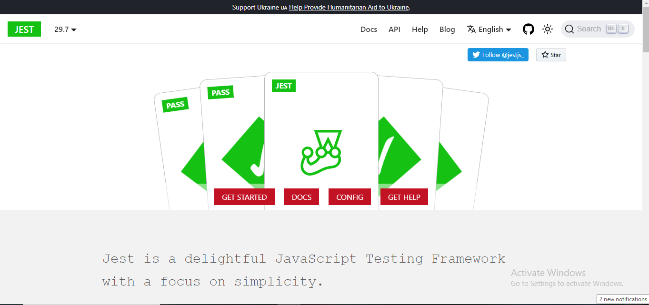
The Jest testing library

Slide 59
Responsible Disclosure Programs
Responsible Disclosure is an ethical method to report system vulnerabilities in our ICT system, which allows us sufficient time to identify and apply the appropriate countermeasures before these vulnerabilities might become public.
It’s possible your internal testing doesn’t cover all potential use cases of your customers.
Because of this, it’s very possible your customers will find vulnerabilities that would otherwise go unreported.
A good, responsible disclosure program will include a list of ways that your users can test your application’s security without incurring any legal risk.
Beyond this, your disclosure program should define a clear method of submission and a template for a good submission.

Slide 60
Responsible Disclosure Programs
Researchers should:
Ensure that any testing is legal and authorised.
Respect the privacy of others.
Make reasonable efforts to contact the security team of the organisation.
Provide sufficient details to allow the vulnerabilities to be verified and reproduced.
Not demand payment or rewards for reporting vulnerabilities outside of an established bug bounty program.

Slide 61
Responsible Disclosure Programs
Organisations should:
Provide a clear method for researchers to securely report vulnerabilities.
Clearly establish the scope and terms of any bug bounty programs.
Respond to reports in a reasonable timeline.
Communicate openly with researchers.
Not threaten legal action against researchers.
Request CVEs where appropriate.
Publish clear security advisories and changelogs.
Offer rewards and credit.

Slide 62
Bug Bounty Programs
Bug bounty programs offer monetary rewards to ethical hackers for successfully discovering and reporting a vulnerability or bug to the application's developer.
Bug bounty programs allow companies to leverage the hacker community to improve their systems’ security posture over time.
Bug bounty programs have been employed by software companies for the last decade, offering cash prizes in exchange for properly submitted and documented vulnerability reports from end users, ethical hackers, and security researchers.

Slide 63
In the beginning, starting a bug bounty program was a difficult process that required extensive legal documentation, a triage team, and specially configured sprint or kanban processes for detecting duplicates and resolving vulnerabilities.
Today, intermediate companies exist to facilitate the development and growth of a bug bounty program.
These companies, like HackerOne and BugCrowd, provide easily customizable legal templates as well as a web interface for submission and triaging.
HackerOne is one of the most popular bug bounty platforms on the web and helps small companies set up bug bounty programs and connect with security researchers and ethical hackers.

Slide 64
Third-Party Penetration Testing
Penetration testing exercises seek to discover existing vulnerabilities in the IT infrastructure.
Third-party penetration testing, or external penetration testing, is a cybersecurity practice.
In this practice, an external firm or individual accesses the security system of the company with the objective of identifying weaknesses and vulnerabilities to restrict attackers from causing potential threats.

Slide 65
Outline
Securing Modern Web Applications
Secure Application Architecture
Reviewing Code for Security
Vulnerability Discovery,
Defending Against XSS Attacks, Defending Against CSRF Attacks,
Defending Against XXE, Defending Against Injection attacks,
Defending Against DoS, Defending against CORS based attacks
Self-learning Topics: Implement the countermeasures to the attacks using open-source tools

Slide 66
Defending Against XSS Attack

Slide 67
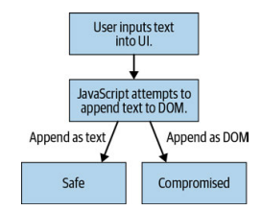
Anti-XSS Coding Best Practices
don’t allow any user-supplied data to be passed into the DOM—except as strings.
never allow any unsanitized user-supplied data to be passed into the DOM.
Notes:
When user-supplied data must be passed into the DOM, it should be done as a string, if possible. This means, in any case where HTML/DOM is NOT required and usersupplied data is being passed to the DOM for display as text, we must ensure that the user-supplied data is interpreted as text and not DOM

Slide 68
<!DOCTYPE html>
<html lang="en">
<head>
<meta charset="UTF-8">
<meta name="viewport" content="width=device-width, initial-scale=1.0">
<title>Unsafe Example</title>
</head>
<body>
<script>
// Assume this data comes from user input or any untrusted source
var userInput = "<img src=x onerror='alert(\"XSS Attack!\")'>";
// Display the user-supplied data in the DOM
document.getElementById("output").innerHTML = userInput;
</script>
<div id="output"></div>
</body>
</html>
Notes:
In this example, the user input is directly inserted into the DOM using innerHTML. If an attacker provides malicious input, it can result in the execution of arbitrary JavaScript code, leading to a potential XSS attack.

Slide 69
<!DOCTYPE html>
<html lang="en">
<head>
<meta charset="UTF-8">
<meta name="viewport" content="width=device-width, initial-scale=1.0">
<title>Safe Example</title>
</head>
<body>
<script>
// Assume this data comes from user input or any untrusted source
var userInput = "<img src=x onerror='alert(\"XSS Attack!\")'>";
// Create a text node to safely insert the user-supplied data
var textNode = document.createTextNode(userInput);
// Append the text node to an element, ensuring it won't be executed as code
document.getElementById("output").appendChild(textNode);
</script>
<div id="output"></div>
</body>
</html>
Notes:
In this improved example, the user input is treated as plain text by creating a text node and appending it to the DOM. This ensures that the content is not interpreted as HTML or JavaScript code, mitigating the risk of XSS attacks. Always follow such practices to sanitize and validate user input before incorporating it into the DOM to maintain a secure web application.

Slide 70
document.getElementById("output").innerHTML = userInput;
document.getElementById("output").textContent = userInput;

Slide 71
Sanitizing User Input
Sanitizing user input is a crucial step in web development to prevent security vulnerabilities, especially Cross-Site Scripting (XSS) attacks.
Sanitization involves validating and cleaning user input to ensure that it doesn't contain malicious code.
When the user input is passed through the sanitizeInput function before being inserted into the DOM, the dangerous code within the input is effectively neutralized.
This practice helps ensure that user-supplied data is displayed safely on the webpage without posing a security risk.

Slide 72
<title>Sanitization Example</title>
</head>
<body>
<script>
// Assume this data comes from user input or any untrusted source
var userInput = "<img src=x onerror='alert(\"XSS Attack!\")'>";
// Function to sanitize user input and prevent XSS attacks
function sanitizeInput(input) {
// Replace '<' with '&lt;' and '>' with '&gt;'
return input.replace(/</g, '&lt;').replace(/>/g, '&gt;');
}
// Sanitize the user input
var sanitizedInput = sanitizeInput(userInput);
// Display the sanitized input in the DOM
document.getElementById("output").innerHTML = sanitizedInput;
</script>
<div id="output"></div>
</body>
</html>
Notes:
In this example, the sanitizeInput function is created to replace the characters < and > with their HTML entity equivalents (&lt; and &gt;). This prevents the browser from interpreting these characters as HTML tags, effectively neutralizing any potential XSS attack.

Slide 73
Stay away from the following APIs when possible:
element.innerHTM`L / `element.outerHTML
Blob
SVG
document.write / document.writeln
DOMParser.parseFromString
document.implementation
Notes:
element.innerHTML / element.outerHTML:
Risk: Using innerHTML or outerHTML to manipulate or insert HTML content can lead to XSS (Cross-Site Scripting) vulnerabilities if not properly sanitized.
Best Practice: Instead, use DOM manipulation methods like createElement, appendChild, or createTextNode combined with proper input validation to dynamically modify HTML content.
Blob:
Risk: If misused, Blobs can lead to security issues, particularly when handling untrusted or unsanitized data.
Best Practice: Exercise caution when dealing with Blobs, especially when creating them dynamically or accepting them as user input. Sanitize and validate input before processing.
SVG:
Risk: SVG images can contain scripts, and if not properly sanitized, they may lead to XSS vulnerabilities.
Best Practice: Sanitize and validate SVG content before rendering. Avoid dynamically injecting untrusted SVG content into the DOM without proper validation.
document.write / document.writeln:
Risk: These methods can cause rendering issues, are considered bad practice, and may introduce XSS vulnerabilities if used to inject untrusted content.
Best Practice: Prefer using DOM manipulation methods and avoid using document.write or document.writeln for dynamic content. Use innerHTML or other DOM methods.
DOMParser.parseFromString:
Risk: While DOMParser is a legitimate API, if used to parse untrusted or unsanitized content, it may introduce XSS vulnerabilities.
Best Practice: If using DOMParser, carefully validate and sanitize input before parsing. Prefer safer alternatives when dealing with user-provided content.
document.implementation:
Risk: Direct use of document.implementation is discouraged, as it's an older API and may have security implications.
Best Practice: Use more modern and secure alternatives when dealing with DOM-related operations. The Document Object Model (DOM) has evolved, and newer methods are available.

Slide 74
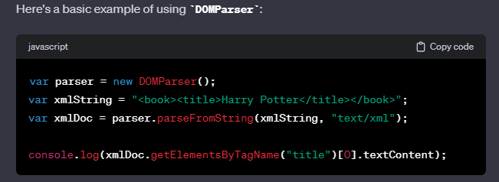
DOMParser Sink
The DOMParser is a built-in JavaScript object that allows you to parse XML or HTML source code into a DOM Document.
It doesn't inherently pose security risks by itself, but how it's used can impact the security of your application, particularly if the parsed content contains user input.
Notes:
The preceding APIs allow developers to easily generate DOM or script from text, and as such are easy sinks for XSS execution.

Slide 75
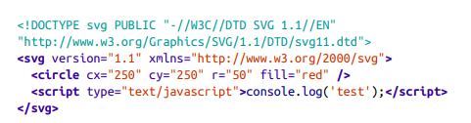
SVG Sink
Scalable Vector Graphics (SVG) are wonderful for displaying images consistently across a wide number of devices, but due to their reliance on the XML spec that allows script execution, they are much riskier than other types of images.

Slide 76
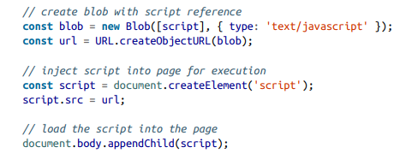
Blob Sink
A "Blob" (Binary Large Object) in web development typically refers to a container for binary data, such as images, videos, or other binary formats. Blobs are often used in scenarios like handling file uploads, creating object URLs for media, or working with data in a binary format.

Slide 77
Few more countermeasures

Slide 78
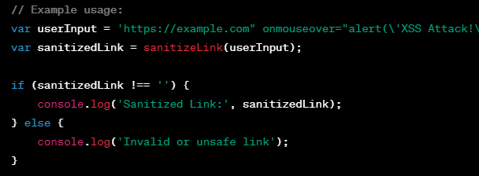
Sanitizing Hyperlinks
Sanitizing hyperlinks, especially user-generated or untrusted links, is crucial to prevent security vulnerabilities such as Cross-Site Scripting (XSS) or other injection attacks.
The sanitizeLink function combines encoding and validation to produce a sanitized link.
Notes:
A sanitizeLink function is typically used to sanitize or validate URLs and ensure that they meet certain security criteria before being used or displayed in a web application. The goal is to prevent potential security vulnerabilities, such as Cross-Site Scripting (XSS) or other injection attacks, that may arise from improperly formatted or malicious URLs.

Slide 79
HTML Entity Encoding
HTML entity encoding is a technique used to represent characters with special meaning in HTML using their corresponding character entities.
This is often done to prevent the browser from interpreting certain characters as HTML or JavaScript code, reducing the risk of security vulnerabilities such as Cross-Site Scripting (XSS).
In HTML, characters like <, >, &, and others have special meanings. By encoding them into their HTML entity equivalents, you can display these characters on a webpage without the browser interpreting them as part of the HTML structure.

Slide 80
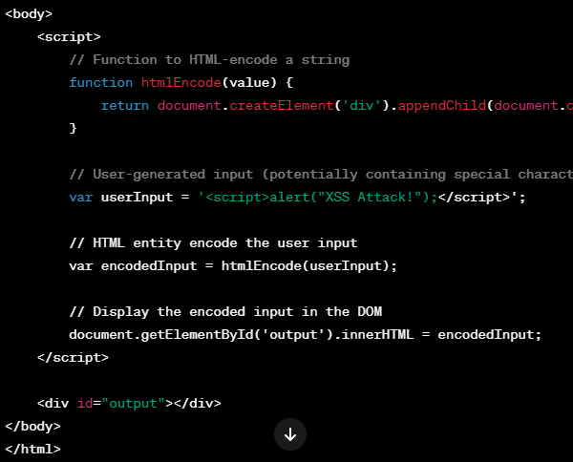
Notes:
The htmlEncode function is used to encode the user input.
The user-generated input contains a script tag that would normally execute JavaScript code.
After encoding, the input is displayed in the DOM, and it won't be executed as JavaScript code.
An htmlEncode function is used to encode HTML entities in a string, preventing HTML injection and Cross-Site Scripting (XSS) attacks. HTML encoding involves replacing special characters with their corresponding HTML entities.

Slide 81
Content Security Policy for XSS Prevention
A Content Security Policy (CSP) is a crucial security mechanism that helps prevent Cross-Site Scripting (XSS) attacks by defining and enforcing a set of rules for the types of content that a web page can load and execute.
A well-configured CSP significantly reduces the risk of malicious script execution by controlling the sources from which certain types of content can be loaded.

Slide 82
commonly used in a CSP header
default-src:
Specifies the default source for content that does not have a specific directive. It helps prevent script execution from unexpected sources.
<meta http-equiv="Content-Security-Policy" content="default-src 'self';">
script-src:
Controls the sources from which scripts can be executed. It helps prevent inline scripts and limits script sources to trusted locations.
<meta http-equiv="Content-Security-Policy" content="script-src 'self' https://trusted-scripts.com;">
Notes:
default-src is a directive used in the Content Security Policy (CSP) header of a web page to define the default policy for loading resources. The default-src directive specifies the default source for content such as scripts, styles, images, fonts, and other resources if a more specific directive is not defined for a particular type of content.
The script-src directive is part of the Content Security Policy (CSP) header in a web page's HTTP response. It specifies the valid sources for JavaScript code execution.

Slide 83
style-src:
Limits the sources from which stylesheets can be loaded. Helps prevent inline styles and restricts the sources for styles.
<meta http-equiv="Content-Security-Policy" content="style-src 'self' https://trusted-styles.com;">
img-src:
Defines the allowed sources for images. Helps prevent loading images from untrusted locations.
<meta http-equiv="Content-Security-Policy" content="img-src 'self' https://trusted-images.com;">
connect-src:
Specifies the sources that can be used for network requests, including AJAX, WebSocket, and EventSource.
<meta http-equiv="Content-Security-Policy" content="connect-src 'self' https://trusted-api.com;">
object-src:
Defines the sources from which plugins and other active content can be loaded.
<meta http-equiv="Content-Security-Policy" content="object-src 'none';">

Slide 84
Outline
Securing Modern Web Applications
Secure Application Architecture
Reviewing Code for Security
Vulnerability Discovery,
Defending Against XSS Attacks, Defending Against CSRF Attacks,
Defending Against XXE, Defending Against Injection attacks,
Defending Against DoS, Defending against CORS based attacks
Self-learning Topics: Implement the countermeasures to the attacks using open-source tools

Slide 85
Defending Against CSRF Attacks

Slide 86
Header Verification
Implementing header verification is a valuable strategy in defending against CSRF attacks.
This involves validating certain headers in the incoming HTTP requests to ensure that they match expected values.
Origin Header Verification
Check the Origin header on the server side to ensure that the request is coming from an expected origin. This header indicates the origin of the request, and if it doesn't match the expected value, the request can be rejected.
if (request.headers.origin !== 'https://www.example.com')
{ // Reject the request }

Slide 87
Referer header
The referer header is set on all requests, and also indicates where a request originated from.
The only time this header is not present is when the referring link has the attribute rel=noreferer set.
A referer header looks like: Referer: https://www.mega-bank.com:80.
It provides information about the source or context of the request, helping the server understand where the user is coming from.

Slide 88
CSRF Tokens
one of the most effective defenses against CSRF (Cross-Site Request Forgery) attacks is the use of anti-CSRF tokens.
These tokens are also known as CSRF tokens or synchronization tokens. The fundamental idea behind anti-CSRF tokens is to validate that a request comes from a legitimate and expected source.
By implementing anti-CSRF tokens, web applications add an extra layer of security, ensuring that only legitimate requests with the correct tokens are processed.
It's important to note that while anti-CSRF tokens are a powerful defense, combining them with other security measures, such as proper header configurations and secure coding practices, further strengthens overall security against CSRF attacks.

Slide 89
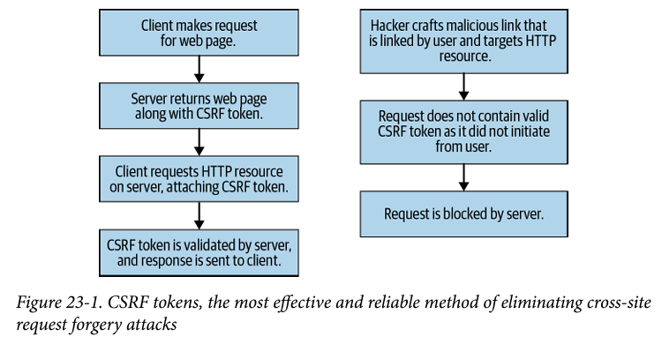
Notes:
At its core, CSRF token defense works like this: 1. Your web server sends a special token to the client. This token is generated cryptographically with a very low collision algorithm, which means that the odds of getting two identical tokens are exceedingly rare. The token can be regenerated as often as per request, but generally is generated per session. 2. Each request from your web application now sends the token back with it; this should be sent back in forms as well as AJAX requests. When the request gets to the server, the token is verified to make sure it is live (not expired), authentic, and has not been manipulated. If verification fails, the request is logged and fails as well. CSRF Tokens | 2493. As a result of requests requiring a valid CSRF token, which is unique per session and unique to each user, CSRF attacks originating from other origins become extremely difficult to pull off. Not only would the attacker need a live and up-todate CSRF token, but they would also now need to target a specific user versus a large number of users. Furthermore, with token expiration compromised, CSRF tokens can be dead by the time a user clicks a malicious link—a beneficial side effect of CSRF tokens as a defensive strategy.

Slide 90
Stateless CSRF Tokens
Stateless CSRF tokens are a variation of traditional CSRF tokens that are designed to work without the need for server-side storage of token information.
Unlike typical CSRF tokens, which are associated with a user's session and stored server-side, stateless CSRF tokens are generated dynamically on the client side and do not require server-side storage.
a stateless CSRF token should consist of the following:
A unique identifier of the user the token belongs to
A timestamp (which can be used for expiration)
A cryptographic nonce whose key only exists on the server

Slide 91
Anti-CRSF Coding Best Practices
There are many methods of eliminating or mitigating CRSF risk in your web application that start at the code or design phase. Several of the most effective methods are:
Refactoring to stateless GET requests
Implementation of application-wide CSRF defenses
Introduction of request-checking middleware

Slide 92
Refactoring to stateless GET requests
Because the most common and easily distributable CSRF attacks come via HTTP GET requests, it is important to correctly structure our API calls to mitigate this risk.
HTTP GET requests should not store or modify any server-side state. Doing so leaves future GET requests or modifications to GET requests open to potential CSRF vulnerabilities.
Application-Wide CSRF Mitigation
This likely refers to implementing consistent and comprehensive CSRF defenses throughout the entire web application.
This could involve the use of anti-CSRF tokens, secure cookie attributes, and other security measures to protect against CSRF attacks on all state-changing operations.
Introduction of request-checking middleware
Middleware can be used to intercept and check incoming requests for various security-related aspects, including CSRF protection.
A request-checking middleware might validate anti-CSRF tokens, headers, or other security-related information before allowing the request to proceed.

Slide 93
Defending Against XXE

Slide 94
XXE (XML External Entity) attacks are a type of security vulnerability that targets applications processing XML data.
In an XXE attack, an attacker can exploit the ability of an XML parser to interpret external entities, potentially leading to disclosure of internal files, denial of service, or remote code execution.

Slide 95
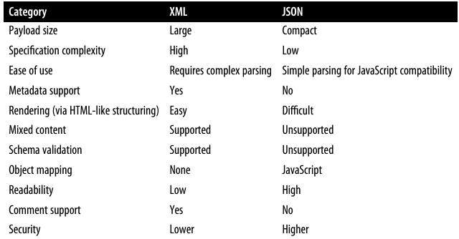
Evaluating Other Data Formats
Typically, XML can be interchanged with JSON, making JSON the default when looking at other formats.

Slide 96
JSON is a much more lightweight format than XML.
JSON offers less rigidity, but brings with it faster and easier to work with payloads.
JSON maps to JavaScript objects, while XML more closely maps to DOM trees (as the DOM is an XML-derived format).

Slide 97
Advanced XXE Risks
Disable External Entity Processing: Where possible, disable the processing of external entities in XML parsers or configure them to disallow the use of external entities.
Use a Secure Parser: Choose XML parsers with built-in protections against XXE vulnerabilities. Modern parsers often have features or configurations to mitigate XXE risks.
Input Validation: Implement strict input validation and sanitize XML input to ensure that only well-formed and expected XML data is processed.
Security Testing: Regularly perform security assessments, including penetration testing and code reviews, to identify and remediate potential XXE vulnerabilities.
Web Application Firewall (WAF): Consider using a WAF that includes specific rules to detect and block XXE attacks.

Slide 98
Vulnerable XML Code Example
<?xml version="1.0" encoding="UTF-8"?>
<!DOCTYPE data [
<!ENTITY file SYSTEM "file:///etc/passwd">
]>
<data>&file;</data>

Slide 99
Example of a Vulnerable XML Parser in Python
import xml.etree.ElementTree as ET
def parse_xml(data):
tree = ET.fromstring(data) # ⚠️ Vulnerable to XXE!
return tree.text
user_input = """<?xml version="1.0"?>
<!DOCTYPE foo [
<!ENTITY xxe SYSTEM "file:///etc/passwd">
]>
<root>&xxe;</root>
"""
print(parse_xml(user_input)) # Server may return file contents!

Slide 100
How to Prevent XXE Attacks
Disable External Entities in the XML Parser
from defusedxml.ElementTree import parse
def safe_parse_xml(data):
return parse(data) # Safe against XXE

Slide 101
Defending Against Injection

Slide 102
Detecting SQL Injection
You can detect SQL injection manually using a systematic set of tests against every entry point in the application. To do this, you would typically submit:
The single quote character ' and look for errors or other anomalies.
Some SQL-specific syntax that evaluates to the base (original) value of the entry point, and to a different value, and look for systematic differences in the application responses.
Boolean conditions such as OR 1=1 and OR 1=2, and look for differences in the application's responses.
Payloads designed to trigger time delays when executed within a SQL query, and look for differences in the time taken to respond.
OAST payloads designed to trigger an out-of-band network interaction when executed within a SQL query, and monitor any resulting interactions.
Notes:
OAST (Out-of-band Application Security Testing)

Slide 103
Prepared Statements
Using prepared statements is an effective technique to prevent SQL injection attacks in database queries.
Prepared statements are a feature provided by database APIs that allow you to separate SQL code from user input, reducing the risk of malicious SQL injection.
How Prepared Statements Work:
Query Template: You create a SQL query template with placeholders for parameters. These placeholders are not directly substituted with user input.
Parameter Binding: You bind the user input to the placeholders in a secure manner. The database API takes care of properly escaping and quoting the input.
Execution: The prepared statement, with bound parameters, is executed by the database. The database engine ensures that user input is treated as data, not executable code.

Slide 104
// Example using Java with JDBC
String username = userInput; // User input
String query = "SELECT * FROM users WHERE username = ?";
try (PreparedStatement preparedStatement = connection.prepareStatement(query)) {
preparedStatement.setString(1, username); // Bind parameter
ResultSet resultSet = preparedStatement.executeQuery();
// Process the result set
} catch (SQLException e) {
// Handle SQL exception
}

Slide 105
In each example, the SQL query contains a placeholder (? in Java and Python, :username in PHP) for the user input.
The actual user input is then bound to this placeholder using appropriate methods provided by the database API. This ensures that the user input is treated as data and not as part of the SQL query, preventing SQL injection attacks.
Always use prepared statements or parameterized queries when interacting with databases to mitigate the risk of SQL injection.
Avoid constructing SQL queries by concatenating strings with user input.

Slide 106
Database-Specific Defenses
each major SQL database offers its own functions for improving security.
Oracle, MySQL, MS SQL, and SOQL all offer methods for automatically escaping characters and character sets deemed risky for use in SQL queries.
The method by which these sanitizations are decided is dependent on the particular database and engine being used.
Oracle (Java) offers an encoder that can be invoked with the following syntax:
ESAPI.encoder().enodeForSQL(new OracleCodec(), str); .
In MySQL, the following can be used to prevent the usage of improperly escaped strings: SELECT QUOTE('test''case');
Notes:
Making use of database-specific string sanitizers for escaping risky character sets reduces the SQL injection risk by making it harder to write an SQL literal versus a string. These should always be used if a query is being run that cannot be paramaterized—though they should not be considered a comprehensive defense but instead a mitigation

Slide 107
Generic Injection Defenses
In addition to being able to defend against SQL injection, you should also make sure your application is defended against other less common forms of injection.
injection attacks can occur against any type of command-line utility or interpreter.
We should be on the lookout for non-SQL injection targets and apply secure-bydefault coding practices throughout our application logic to mitigate the risk of an unexpected injection vulnerability appearing.

Slide 108
Potential Injection Targets
Typically, when on the lookout for injection, the following are high-risk targets:
Task schedulers
Compression/optimization libraries
Remote backup scripts
Databases
Loggers
Any call to the HOST OS
Any interpreter or compiler
When first ranking components of your web application for potential injection risk, compare them with the preceding list of high-risk targets. Those are your starting points for investigation. Dependencies can also be a risk, because many dependencies bring in their own (sub) dependencies that can often fall into one of those categories.

Slide 109
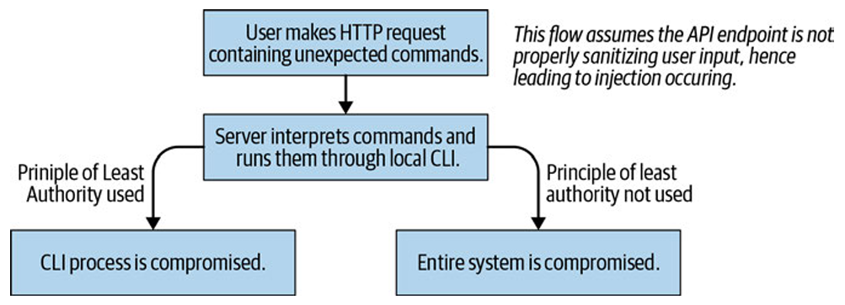
Principle of Least Authority
The principle states that in any system, each member of the system should only have access to the information and resources required to accomplish their job

Slide 110
In the world of software, the principle can be applied as such: “each module in a software system should only have access to the data and functionality required for that module to operate correctly.”
The principle of least authority may seem like a roadblock to developers—managing additional accounts, multiple keys, etc.—but proper implementation of this principle will limit the risk your application is exposed to in the case of a breach.

Slide 111
Whitelisting Commands
The biggest risk for injection is a functionality in a web application where the client (user) sends commands to a server to be executed. This is a bad architectural practice, and should be avoided at all costs.
Instead of allowing user commands to be interpreted literally by the server, a well-defined whitelist of user-available commands should be created.
This, in addition to a well-defined acceptable syntax for commands (order, frequency, params), should be used together, all stored in whitelist format rather than blacklist format.

Slide 112
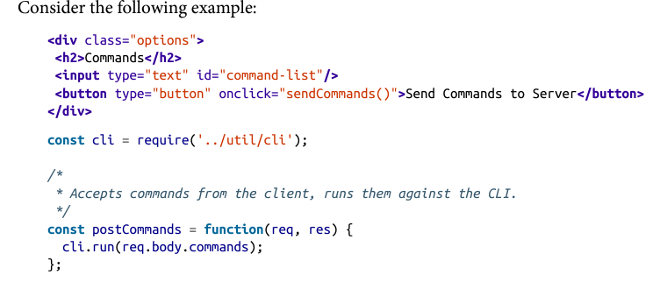
Notes:
In this case, the client is capable of executing any commands against the server that are supported by the cli library. This means that the cli execution environment and full scope are accessible to the end user simply by providing commands that are supported by the cli, even if they are not intended for use by the developer.

Slide 113
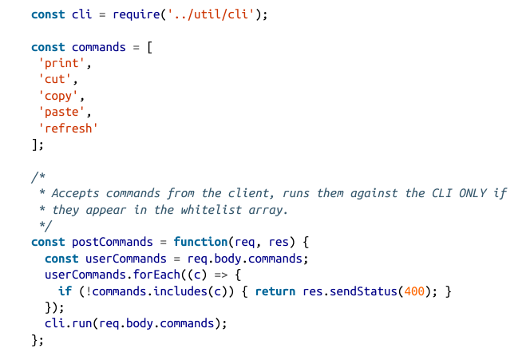

Slide 114
Defending Against DoS

Slide 115
DoS attacks are structured with one or more of the following results in mind:
Exhaust server resources
Exhaust client resources
Request unavailable resources
a first measure against DoS-style attacks should be building up a comprehensive enough logging system in your server that all requests are logged alongside their time to respond.
Manually log the performance of any type of async “job"-style functions, such as a backup that is called through your API but runs in the background and does not generate a response once it completes.
Doing this will allow you to find any attempts (accidental or malicious) at exploiting a DoS vulnerability (server side) that would have otherwise been difficult and time-consuming.

Slide 116
Protecting Against Regex DoS
Here are some strategies to protect against Regex DoS:
Limit Input Length:
Avoid Excessive Backtracking:
Use Possessive Quantifiers:
Use Atomic Groups:
Limit Repetition:
Precompute Regular Expressions:
Rate Limiting:
Use Library Features:
Input Whitelisting:
Runtime Monitoring:
Notes:
Here are some strategies to protect against Regex DoS:
Limit Input Length:
Limit the length of the input that is processed by regular expressions. This helps prevent the construction of excessively long strings that could trigger exponential backtracking.
Avoid Excessive Backtracking:
Optimize your regular expressions to reduce the potential for exponential backtracking. Be mindful of nested quantifiers and alternations that can lead to inefficient matching.
Use Possessive Quantifiers:
Where possible, use possessive quantifiers (*+, ?+, {n,}+, etc.) instead of traditional greedy quantifiers (*, ?, {n,}, etc.). Possessive quantifiers don't backtrack, making them more efficient.
Use Atomic Groups:
Atomic groups (?>...) prevent backtracking into the group once it has matched. This can be useful in scenarios where backtracking is not necessary.
Limit Repetition:
Limit the repetition of quantifiers in your regular expressions. For example, avoid constructs like .* that can match large portions of text.
Precompute Regular Expressions:
If your regular expressions are constant and known in advance, consider precomputing them rather than dynamically generating them based on user input.
Rate Limiting:
Implement rate limiting for regular expression evaluations. Limit the number of regular expression evaluations that can be performed within a given time frame.
Use Library Features:
Some regular expression libraries and engines provide features or flags specifically designed to mitigate ReDoS. For example, the re2 library has a timeout feature that limits the evaluation time.
Input Whitelisting:
Use input whitelisting or allow-listing to restrict input to a known set of safe characters. This can help prevent maliciously crafted input designed to trigger ReDoS.
Runtime Monitoring:
Implement runtime monitoring of regular expression evaluations. If an evaluation takes an unusually long time, log or terminate the process to prevent DoS.
It's important to note that preventing ReDoS requires a combination of input validation, regular expression optimization, and runtime monitoring. Regular expressions can be powerful tools, but they must be used judiciously and with consideration for potential security risks, especially in scenarios involving untrusted user input.

Slide 117
Protecting Against Logical DoS
Logical Denial of Service (Logical DoS) attacks, also known as Algorithmic Complexity Attacks, involve exploiting the inherent complexity of algorithms to consume excessive computational resources and degrade the performance of a system. These attacks often target algorithms that have high worst-case time complexity.

Slide 118
Limit Input Complexity:
Rate Limiting:
Resource Quotas:
Timeouts and Deadlines:
Parallelization Limits:
Algorithmic Complexity Analysis:
Use Efficient Data Structures:
Caching and Memoization:
Heuristic Detection:
Regular Security Audits:
Notes:
Limit Input Complexity:
Implement restrictions on the complexity of input data, especially in scenarios where the input directly influences algorithmic decisions. For example, limit the depth of nested structures, the length of input strings, or the number of iterations in loops.
Rate Limiting:
Implement rate limiting to restrict the number of requests or operations that a user or IP address can make within a specified time frame. This helps prevent an attacker from overwhelming the system with a large number of requests.
Resource Quotas:
Set resource quotas for various operations to ensure that a single request or user cannot consume an excessive amount of resources. This includes limiting CPU time, memory usage, or the number of database queries.
Timeouts and Deadlines:
Enforce timeouts and deadlines for operations to limit the amount of time that a request is allowed to consume resources. If an operation exceeds the allotted time, terminate it and return an appropriate response.
Parallelization Limits:
Control the parallelization of tasks to prevent an attacker from launching multiple parallel requests that collectively lead to resource exhaustion. Limit the concurrency of certain operations.
Algorithmic Complexity Analysis:
Analyze the worst-case time complexity of critical algorithms in your application. Identify and optimize algorithms that have high complexity, especially those that handle untrusted input.
Use Efficient Data Structures:
Choose efficient data structures for storing and processing data. Consider the trade-offs between time and space complexity. In some cases, using more efficient algorithms or data structures can mitigate the impact of potential attacks.
Caching and Memoization:
Implement caching and memoization to store the results of expensive computations. If the same computation is requested multiple times with the same input, retrieve the cached result instead of recomputing it.
Heuristic Detection:
Implement heuristic-based detection mechanisms to identify patterns indicative of a potential Logical DoS attack. For example, monitor request patterns for unusually complex input or excessive resource usage.
Regular Security Audits:
Conduct regular security audits and performance testing to identify and address vulnerabilities that could be exploited for Logical DoS attacks. Pay attention to algorithms and operations that could be resource-intensive.

Slide 119
DDoS Mitigation
The easiest way to defend your web application against a DDoS attack is to invest in a bandwidth management service.
These services are developed by many vendors on the market, but ultimately perform analysis on each packet as it passes through their servers.
The services run well-established scans on the packet to determine if it appears to be coming in a malicious pattern or not.
If a packet is determined to be malicious, it will not be forwarded to your web server.
These bandwidth management services are effective because they are capable of intercepting large quantities of network requests, while your application’s infrastructure is likely not.

Slide 120
blackholing
Suspicious-looking (or repeated) traffic is sent to a blackhole server, which appears to function like your application sever, but performs no operations.
Legitimate traffic is routed to your legitimate web application server as usual.
Unfortunately, while black holes are effective at rerouting malicious traffic, they may also reroute legitimate traffic if not targeted with sufficient accuracy.
Blackholes do a good job against small DDoS attacks, but do not perform well against large-scale DDoS attacks.

Slide 121
Defending Against CORS-Based Attacks
Cross-Origin Resource Sharing (CORS) is a security feature implemented by web browsers to restrict how resources on a web page can be requested from a different domain than the one that served the page.
CORS allows web applications to bypass the Same-Origin Policy (SOP) when necessary, enabling controlled cross-origin requests. However, misconfigurations can lead to security vulnerabilities.
Overly Permissive Policies (Access-Control-Allow-Origin: *)
Misuse of Credentials (Access-Control-Allow-Credentials: true)
Unintended Exposure of Sensitive Data

Slide 122
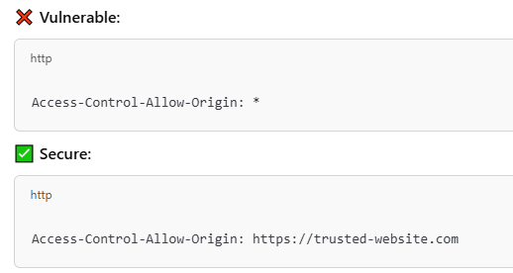
Best Practices
Restrict Access-Control-Allow-Origin
Do not use * (wildcard) unless absolutely necessary.
Instead, specify trusted origins explicitly.

Slide 123
Example
const allowedOrigins = ['https://trusted-site.com', 'https://another-trusted.com'];
app.use((req, res, next) => {
const origin = req.headers.origin;
if (allowedOrigins.includes(origin)) {
res.setHeader('Access-Control-Allow-Origin', origin);
}
next();
});

Slide 124
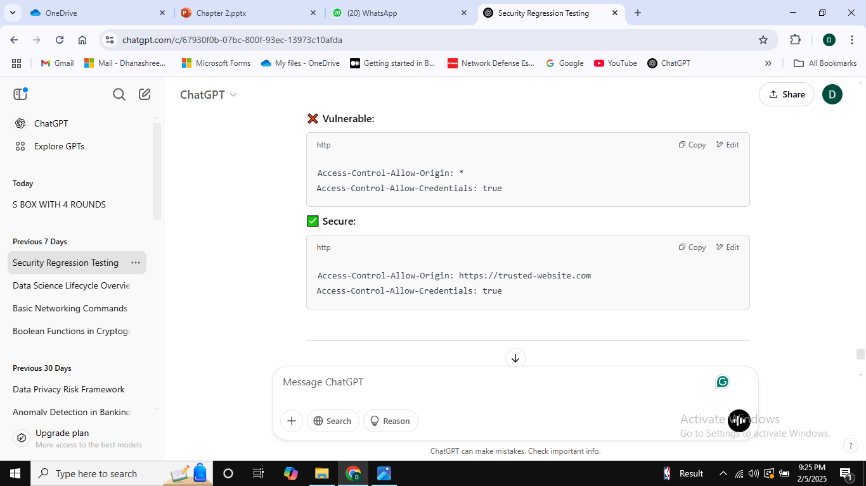
Best Practice
Be Cautious with Access-Control-Allow-Credentials
Only enable credentials (true) if the origin is strictly defined (never use * with credentials).
If credentials (cookies, HTTP authentication) are not needed, disable them.

Slide 125
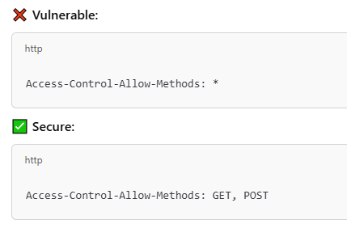
Best Practice
Restrict Allowed Methods (Access-Control-Allow-Methods)
Allow only necessary HTTP methods (GET, POST instead of allowing all).

